Slide 1
Team member
Presentation
Software Reverse Engineering
Kasper van der Pol 111012014
童柏鈞 111598027
楊佑鴻 111598031
Abdiasis Ahmed 110998410
Pradeep Rajasekar 110998409

Slide 2

NTUT Website
Presentation outline:
Introducing the topic
Introducing different attack vectors
Talking about the different attack vectors
Summary
Q&A

Slide 3
Our topic: NTUT attack & defence vectors
Why did we choose this?
What are different attack vectors?
XXS(cross site script)
Man-in-the-middle attack
SQL injection
cross-site request forgery (CSRF or XSRF)
DNS SPOOFING
Third and Fourth Vendor Attack

Slide 4
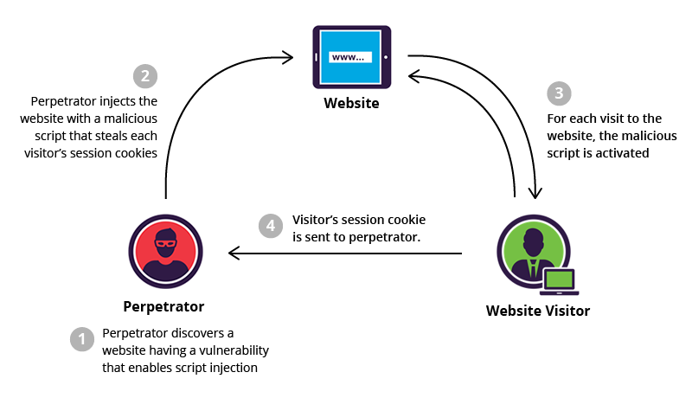
XSS(cross site scripting)
There three common types of XSS attack
Reflected XSS
Stored XSS
DOM-based XSS

Slide 5
Reflected XSS
If an attacker can control a script that is executed in the victim's browser, then they can typically fully compromise that user. Amongst other things, the attacker can:
Perform any action within the application that the user can perform.
View any information that the user is able to view.
Modify any information that the user is able to modify.

Slide 6
How to prevent Reflected XSS
Test every entry point
Submit random alphanumeric values
Determine the reflection context
Test a candidate payload
Test alternative payloads
Test the attack in a browser
Notes:
https://portswigger.net/web-security/cross-site-scripting/reflected

Slide 7
Stored XSS
An attacker injects malicious code in a request to submit content to the application.
The application believes the request is innocent, processes the user input and stores it in the database.
From this point onwards, every time the submitted content is displayed to users, the malicious code executes on their browsers.
Notes:
https://portswigger.net/web-security/cross-site-scripting/stored

Slide 8
How to prevent Stored XSS
Secure handling of user input
Request blocking
Escaping
Choosing the right framework
Mitigating the damage of an XSS attack
Notes:
https://brightsec.com/blog/stored-xss/

Slide 9
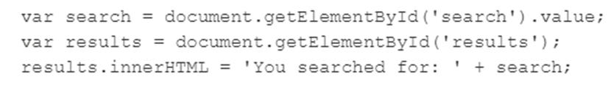
DOM-based XSS
DOM Based XSS is an XSS attack wherein the attack payload is executed as a result of modifying the DOM “environment” in the victim’s browser used by the original client side script, so that the client side code runs in an “unexpected” manner.

Slide 10
How to prevent Dom-Based XSS
programming should choose the right methods,attributes to operate DOM.(ex:choose innerText rather than innerHTML)
Don’t use client data for sensitive actions
Sanitize client-side code
Use Content Security Policy (CSP)
Automated detection of DOM XSS vulnerabilities
Notes:
https://brightsec.com/blog/dom-based-xss/

Slide 11
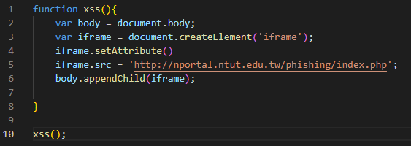

How to attack NTUT website with XSS
Create a malicious script (XSS.js)
Insert payload into XSS page
3. Cover the original web with iframe
label.

Slide 12
Testing Tools
Checkpoint
Invicti
Veracode Dynamic Analysis
Checkmarx
The DOM XSS Wiki
DOM Snitch

Slide 13
Testing Tools
IAST
The tool uses automated testing, manual testing or any interface that can interact with the application to discover the weaknesses of the application
ToolLists: Seeker IAST, WebInspect IAST

Slide 14
Man-In-The-Middle Attack
Man-in-the-middle attacks (MITM) are a common type of cybersecurity attack that allows attackers to eavesdrop on the communication between two targets.
The attack takes place in between two legitimately communicating hosts, allowing the attacker to “listen” to a conversation they should normally not be able to listen to, hence the name “man-in-the-middle.”

Slide 15
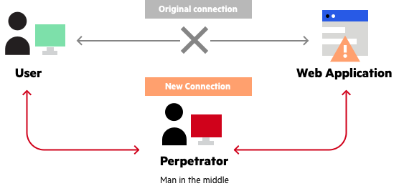
MITM

Slide 16
Prevent Man-In-The-Middle Attack
Secure communication protocols, including TLS and HTTPS
Help mitigate spoofing attacks by robustly encrypting
Authenticating transmitted data

Slide 17
Analysis Root Cause
What is the root cause of MITM in our system?
How do we defense MITM in our system?

Slide 18




cross-site request forgery (CSRF or XSRF)
CSRF is an attack where the attacker causes the victim user to carry out an action unintentionally while that user is authenticated.
Attacker Victim login portal
https://nportal.ntut.edu.tw/ https://nportal.ntut.edu.tw/
change ?username or passwor Set Cookie

Slide 19
How does CSRF Work?
attacker create a request in the form of a URL for their own benefit fro a website
a attacker embeds that request into a htber links and sends to victims who they hope is logged in to the site
the website victim clicks the lin ,unwittingly sending the request to the site
assuming the request is legitimate , the website fullfills the request ,sending data funds or access to the attacker.

Slide 20
How to construct a CSRF attack
The easiest way to construct a CSRF exploit is using the CSRF PoC generator that is built in to Burp Suite Professional:
Select a request anywhere in Burp Suite Professional that you want to test or exploit.
From the right-click context menu, select Engagement tools / Generate CSRF PoC.
Burp Suite will generate some HTML that will trigger the selected request (minus cookies, which will be added automatically by the victim's browser).
Copy the generated HTML into a web page, view it in a browser that is logged in to the vulnerable web site, and test whether the intended request is issued successfully and the desired action occurs.

Slide 21
CSRF attack to be possible three conditions
A relevant action. There is an action within the application that the attacker has a reason to induce. This might be a privileged action (such as modifying permissions for other users)
Cookie-based session handling. Performing the action involves issuing one or more HTTP requests, and the application relies solely on session cookies to identify the user who has made the requests.
No unpredictable request parameters. The requests that perform the action do not contain any parameters whose values the attacker cannot determine or guess

Slide 22
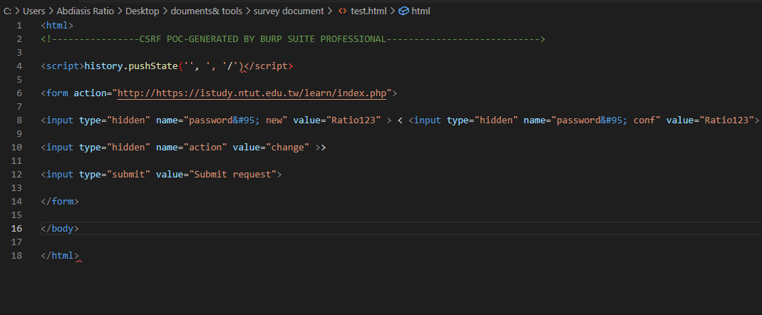
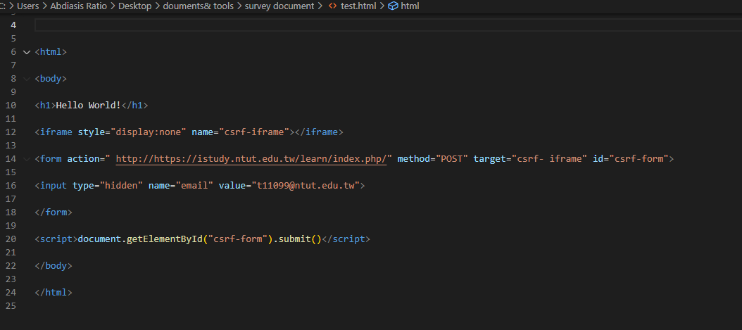
Exploiting CSRF Vulnerabities
GET & POST Scenario
GET https://nportal.ntut.edu.tw/index.do?thetime=1672924992456 HTTP/1.1
Host: nportal.ntut.edu.tw
Exploit : create an HTML form automatically for intercepted data.

Slide 23
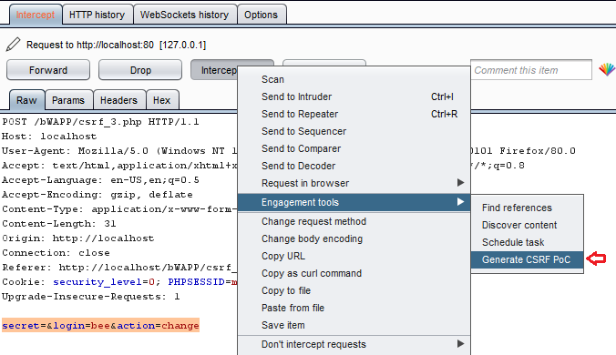
procedure for the CSRF attack use burp suite to capture

Slide 24
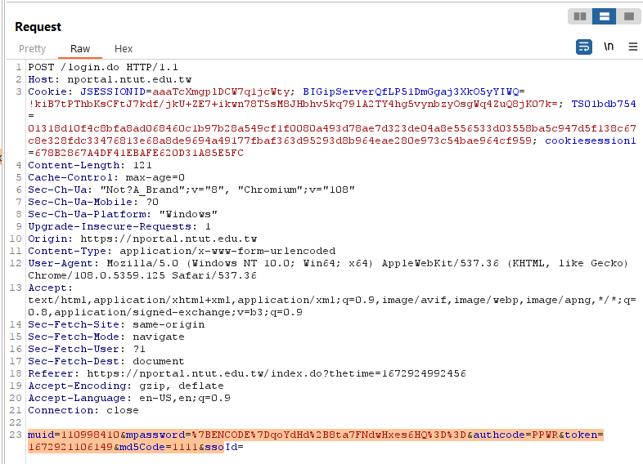
fire up the Change NTUT student portal password and capture the passing HTTP Request over in the Burpsuite.
we have successfully captured the request. Time to create a Fake HTML form, .

Slide 25
What is the impact of a CSRF attack?
Depends on the functionality in the application that is being exploited
confidentiality- it can be none /partial (low)/high
integrity - usually either partial or high
Avaailability- can be none /partial (low)high
For example, this might be to change the email address on their account, to change their password. Depending on the nature of the action, the attacker might be able to gain full control over the user's account.

Slide 26
Preventing CSRF attacks
To defend against CSRF attacks is to include a CSRF token within relevant requests. The token should be:
Unpredictable with high entropy, as for session tokens in general.
Tied to the user's session.
Strictly validated in every case before the relevant action is executed.
Verify: The user will confirm login details before taking a sensitive action.
Developers should require anti-forgery tokens for any unsafe methods (POST, PUT, DELETE) and ensure that safe methods (GET, HEAD) do not have any side effects.

Slide 27
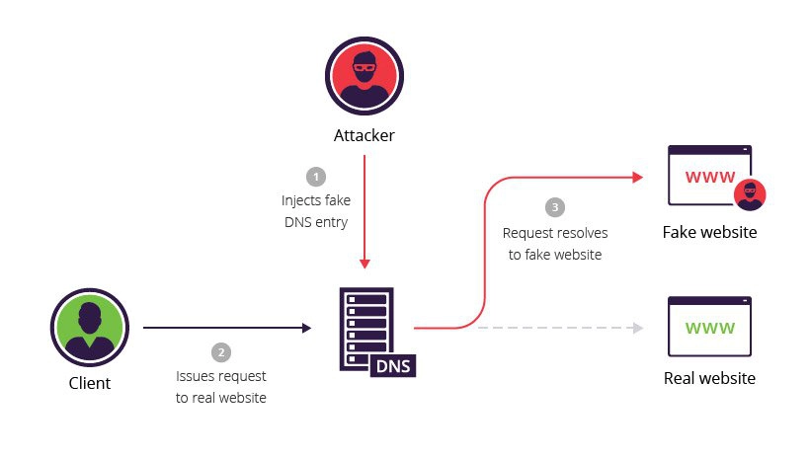
DNS Cache Poisoning(DNS Spoofing)
DNS poisoning is a hacker technique that manipulates known vulnerabilities within the domain name system .
Methods for executing a DNS spoofing attack include:
Man in the middle (MITM) – The interception of communications between users and a DNS server in order to route users to a different/malicious IP address.
DNS server compromise – The direct hijacking of a DNS server, which is configured to return a malicious IP address.

Slide 28
How Does DNS Spoofing Work?
Step 1: Accessing the DNS server
Step 2: Rerouting Connections
Step 3: Accessing Sensitive Data
How to Protect Your Endpoints Against DNS Spoofing
Set up DNSSEC
Look for the secure connection symbol
. Regularly apply patches to DNS servers
Perform thorough DNS traffic-filtering

Slide 29
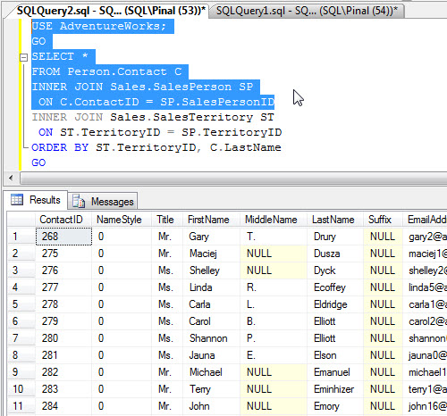
SQL injection
SQL - Structured Query Language
The language for your database
‘Query’ code statement
Returns data from the database

Slide 30
SQL injection
Say you are browsing news on the NTUT website
URL might be ntut.edu.tw/news?p=jan2023
The SQL statement might then look like this:
SELECT title, text FROM db.news WHERE month=’jan2023’;
The web-page will then render the returned items on their page

Slide 31
SQL injection
In an SQL injection attack, we intend to ‘trick’ the web-page into displaying different data from their database
Say we use the following URL
ntut.edu.tw/news?p=jan2023’ UNION SELECT username, password FROM db.users !–-
The sql statement would now look as the following:
SELECT title, text FROM db.news WHERE month=’jan2023’ UNION SELECT username, password FROM db.users !—’;
Everything after the ‘!--’ gets commented out, and thus the new query returns the news articles as well as every username and password in the database

Slide 32
Normal & Blind SQL injection
Normal: We are able to view visual feedback from the web-page
i.e.: Data gets displayed on the page on a successful attack
Blind: On a successful attack, we’re not able to view data on the web-page
Detected through injected sleep() statements
Inject sleep(20) and see if the web-page loads at a 20 second delay or not.

Slide 33
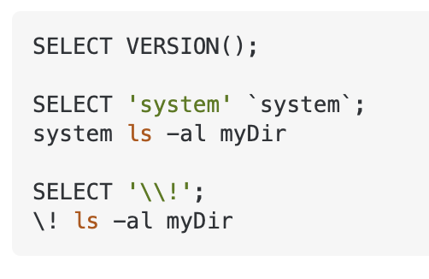
How can SQL injections be exploited?
Data harvesting - Data that is supposed to be hidden (i.e. usernames and passwords) get harvested from the database.
Login bypass - Trick the login implementation to always return true
‘ OR 1=1—-
Executing SQL or shell commands

Slide 34
How do we detect SQL injections in our applications?
Test all user input!
Automatic & manual testing
Automatic:
SQLMap - Enumerates a list of possible SQL injection payloads to see if one works
Nessus
ZAP
Manual:
Manual penetration testing

Slide 35
How do we defend ourselves against SQL injections?
‘Sanitize’ your user input before it hits the database!
This means to scan over every user input for possible illegal metacharacters (‘, “, /, \, etc) and to remove these.
This way the attacker cannot escape the SQL parameter
Frameworks like Entity Framework will do this for you automatically!

Slide 36
Third and Fourth Vendor Attack
One often overlooked attack vector is your third and fourth-party vendors and service providers.
The rise in outsourcing means that your vendors pose a huge cybersecurity risk to your customer's data and your proprietary data.
It doesn't matter how sophisticated your internal network security and information security policies are if vendors have access to sensitive data, they are a huge risk to your organization.
Some of the biggest data breaches were caused by third parties.

Slide 37
Type of Ventors
Manufacturers and suppliers (everything SaaS to Partner Schools)
Services providers
Short and long-term contractors.

Slide 38
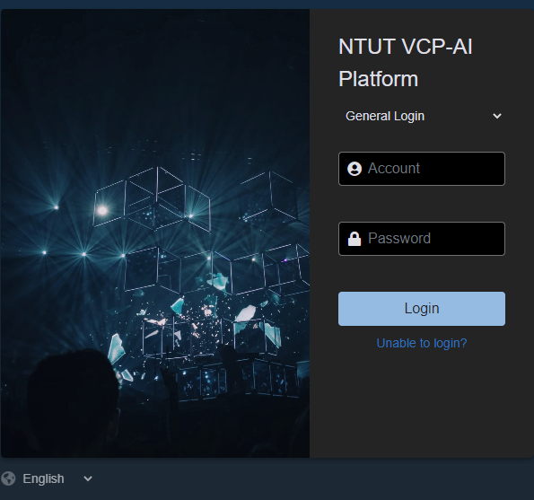
NTUT Vendors
Beike VCP-AI Computing Platform
Beijing University of Technology
Possibility of Attack includes any or all the method we discussed so far.

Slide 39
Regulatories
The demand and need for vendor risk management has grown in recent years due to the introduction of laws like the EU General Data Protection Regulation (GDPR)
Before considering a new vendor, perform a cybersecurity risk assessment and ask them thris SOC 2 compliance.
Contracts of any length can pose a risk to your organization and the Internal Revenue Service (IRS) has regulations about vendor and third-party relationships that go beyond specific time frames so even the length of a contract can pose risk.

Slide 40
Prevention
Third-party risk management framework
Third-party risk management (TPRM). This could include controlling access to our organization's intellectual property, data, operations, finances, customer information or other sensitive information.
Vendor management policy
Implementing an annual inspection or replacing existing vendors with new vendors who meet security service level agreements (SLA) and SOC 2 security requirements.
Evaluate new and existing vendors again by putting out RFPs at the end of each contract life cycle.
Vendor risk management program.
Vendor risk management programs have a comprehensive plan for the identification and mitigation of business uncertainties, legal liabilities, and reputational damage.

Slide 41
Q&A
Thank You

